Slide 1
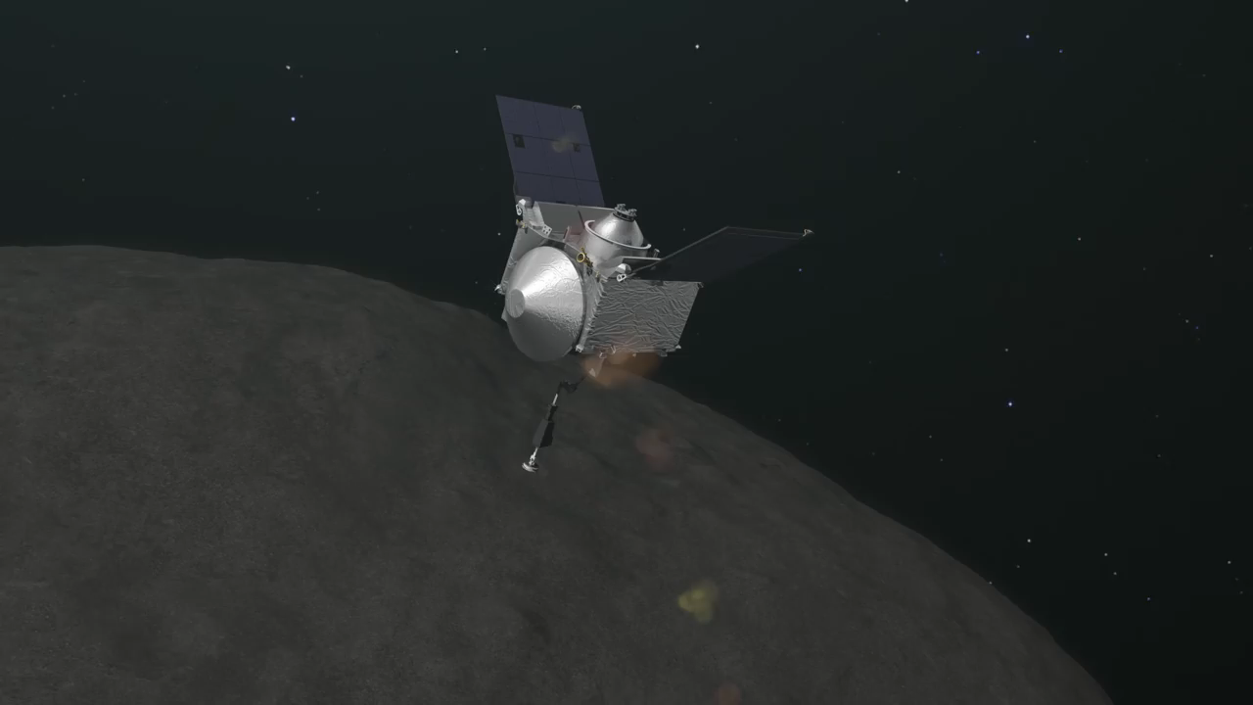

Autonomous Guidance for Asteroid Descent using Successive Convex Optimisation
Dual Quaternion Approach
S. Hazra
Dr. ir. E. Mooij | TU Delft, Astrodynamics and Space Missions
Dr. ir. M. Sagliano | Deutsches Zentrum fur Luft-und Raumfahrt e.V.

Slide 2
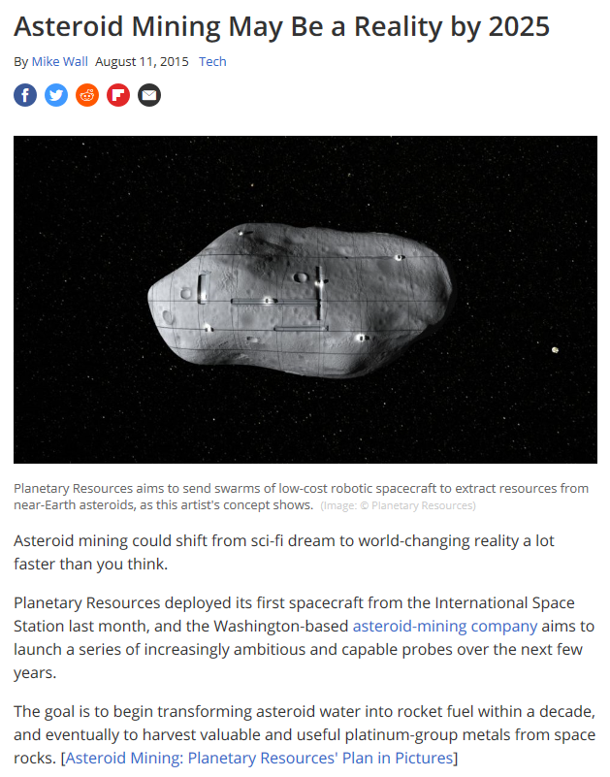
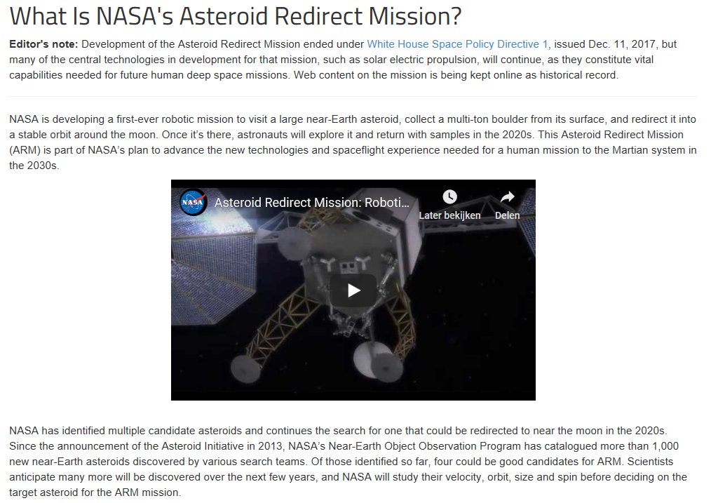
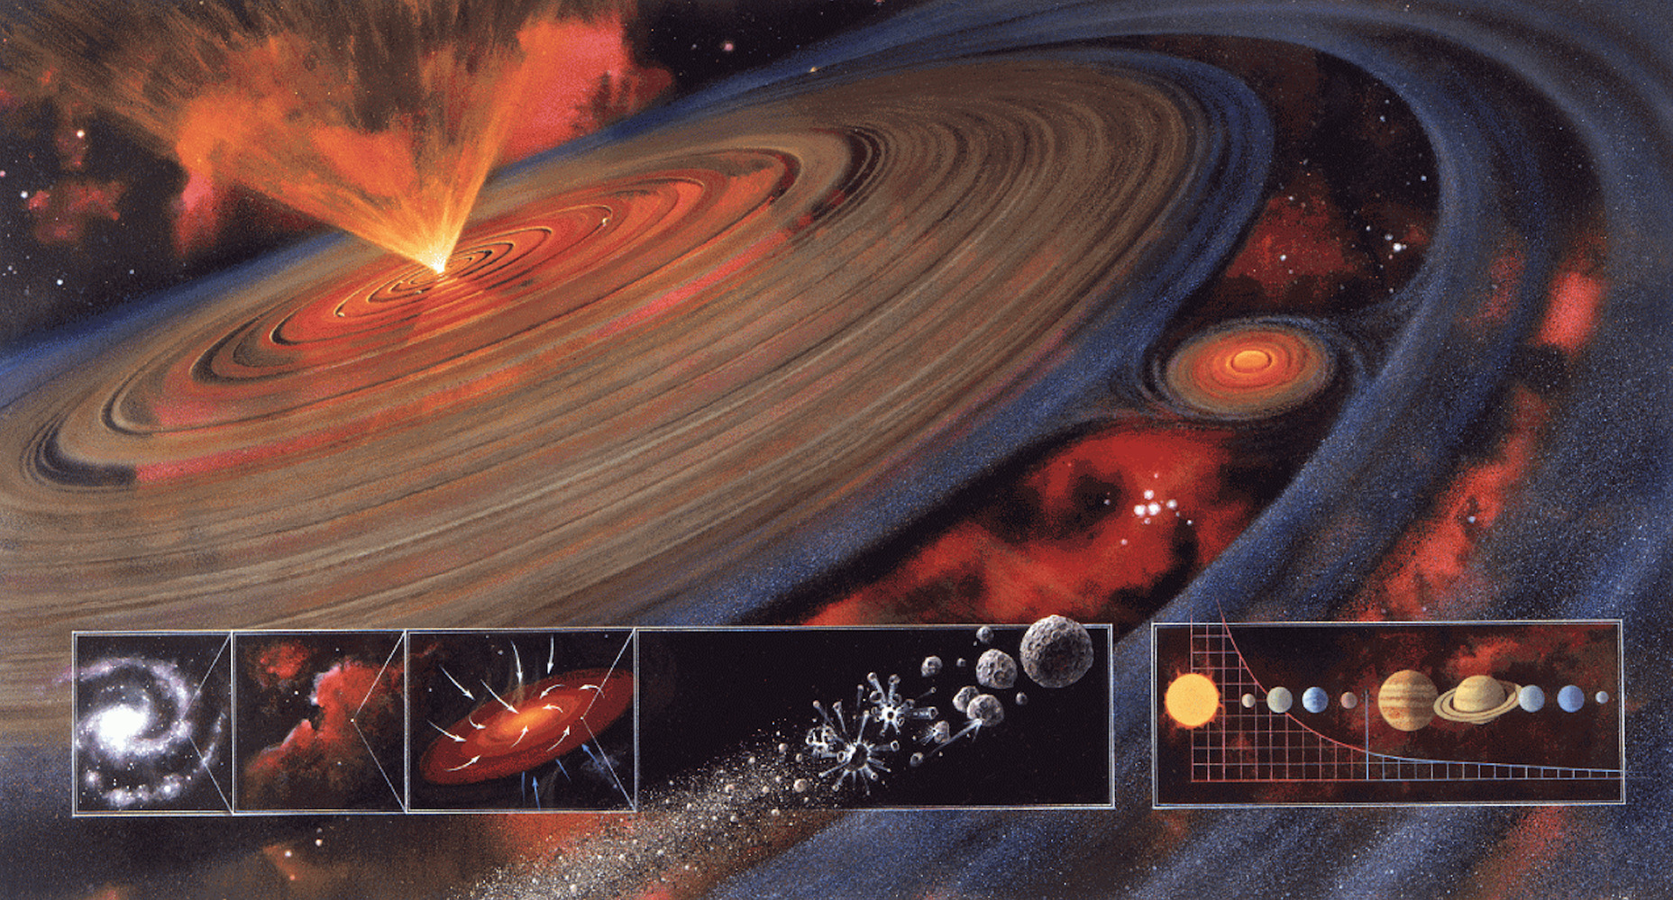

Why Asteroids?
Introduction
Research Question
Mission Overview
Methodology
Simulator Verification
Results
Conclusions
Recommendations
Notes:
Asteroids are pristine remnants from the planetary formation. The study of their composition can help understand the process better. They are plentiful in resources and stand as an option for mining.
Chelyabinsk impact, 20 m dia asteroid, shockwave across six cities. The threat of impact with Earth, requires missions like asteroid redirect mission. They are therefore a hot topic at present.

Slide 3
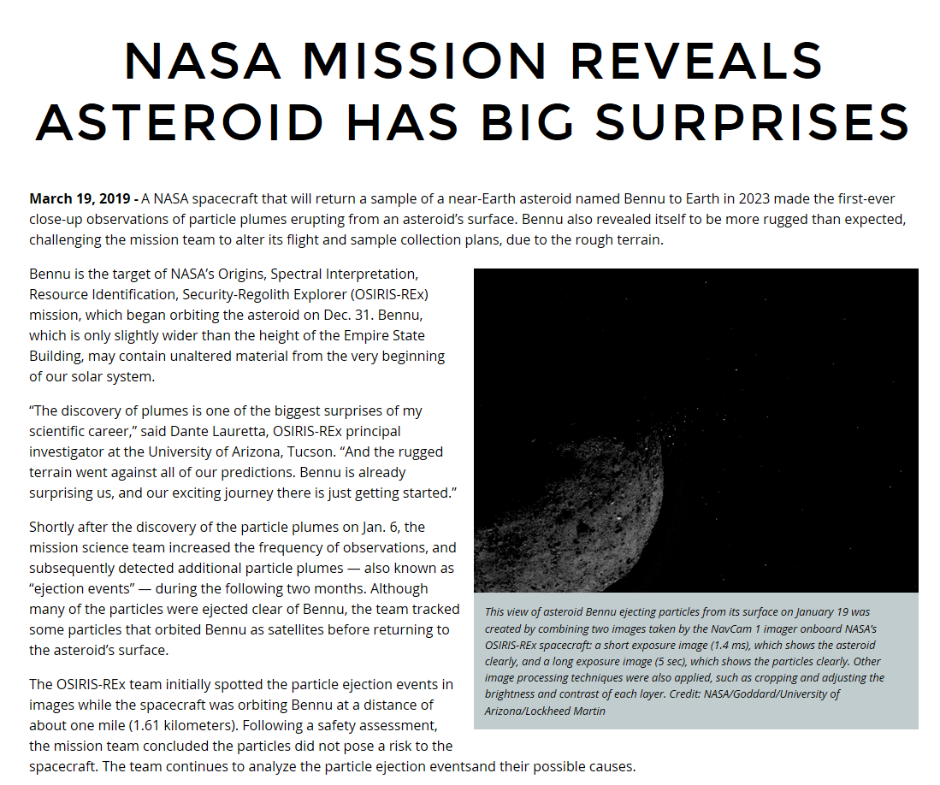
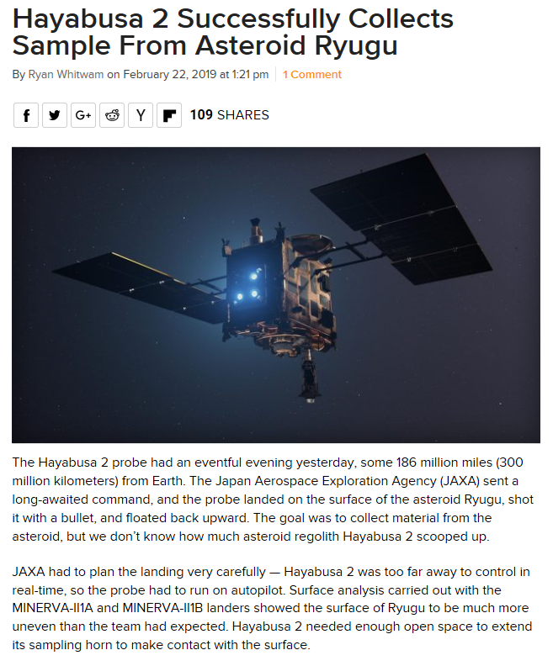
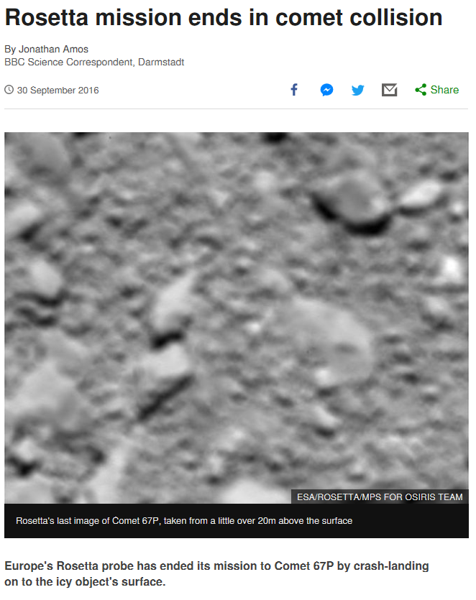
Recent Missions
Introduction
Research Question
Mission Overview
Methodology
Hayabusa 2
Rosetta
Simulator Verification
OSIRIS-REx
Results
Conclusions
Recommendations
Notes:
The most current missions to asteroids that have either conducted sampling missions or close proximity operations to small bodies are: . The current phases of these missions are as follows.
For this thesis we take inspiration from Osiris Rex and Rosetta, since we would like to present a solution for a sampling mission for MAB asteroids. (These are between Mars and Jupiter and also less weathered due to their further positioning from the sun as compared NEAs).

Slide 4
Why dual quaternions (DQs)?
Introduction
General 6DOF representation
Position: Cartesian coordinates
Attitude: Quaternion
Dual Quaternion 6DOF representation
Position: Quaternion
Attitude: Quaternion
Research Question
Mission Overview
Methodology
Simulator Verification
Results
Conclusions
Recommendations
Advantages of dual quaternions
One transformation for both rotation and translation
Compact representation of 6DOF kinematics and dynamics
Similar properties as quaternions
Notes:
Others available for attitude: Euler rotation, MRPs
Dual quaternions: 8 tuple representation, one transformation for both rotation and translation

Slide 5
Why autonomous guidance?
Introduction
Research Question
A priori information about asteroids is limited
Perturbed and variable environment
Shapes, rotation rates and densities might be irregular or variable
Distance from Earth around 1.1-2 au
Mission Overview
Methodology
Simulator Verification
Results
Conclusions
Recommendations
Notes:
1. shape, size, rotation rates, densities etc
2. Highly perturbed, Non central gravity field – SRP – 3BP– stable orbits can turn to crashing or escape orbits (seen in mission also Philae)
3. fast rotation – dynamics unpredictable
4. MAB – 2.1 to 3 au, communication ~17 to 33 mins, remote operation costly, delay in comm in unforeseen circumstances (The further we go from the sun, the sampled material becomes more and more primitive. )
5. Restrictions on SC design for fuel requirements

Slide 6
What are the available guidance technologies?
Introduction
Research Question
Mission Overview
Selected Autonomous Guidance Technologies
Successive Convex Optimisation
Sampling Based Model Predictive Optimisation
Pseudospectral Methods
Artificial Potential Functions
Convex Optimisation
Sampling Based Motion Planning
Methodology
Simulator Verification
Results
Conclusions
Recommendations
Notes:
1. shape, size, rotation rates, densities etc
2. Highly perturbed, Non central gravity field – SRP – 3BP– stable orbits can turn to crashing or escape orbits (seen in mission also Philae)
3. fast rotation – dynamics unpredictable
4. MAB – 2.1 to 3 au, communication ~17 to 33 mins, remote operation costly, delay in comm in unforeseen circumstances (The further we go from the sun, the sampled material becomes more and more primitive. )
5. Restrictions on SC design for fuel requirements

Slide 7
How can a spacecraft autonomously descend for a touch-and-go sampling process to a chosen landmark robustly and optimally, while being accurate and safe?
Introduction
Research Question
Mission Overview
How can the SC attitude and orbital dynamics be represented by dual quaternions?
What are the cost functions that need to be optimised, the constraints they are subject to and how can they be formulated with dual quaternions?
How can the method of successive convex optimisation (SCvx) be implemented to optimise the derived cost functions?
What methods can be used to verify and validate the subsystems and guidance algorithm to qualify the system to be accurate, safe and robust?
How useful is this representation and can it be used in real time autonomous applications?
How can the method of sampling based model predictive optimisation (SBMPO) be used to map a small Solar System body autonomously to provide the SC with a safe landmark for descent?
Methodology
Simulator Verification
Results
Conclusions
Recommendations

Slide 8
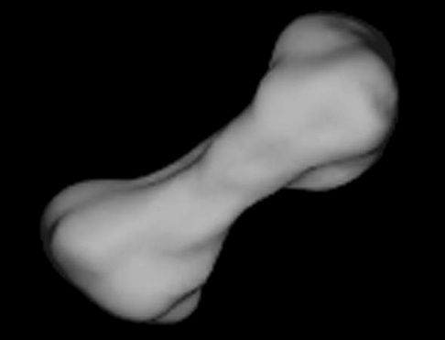
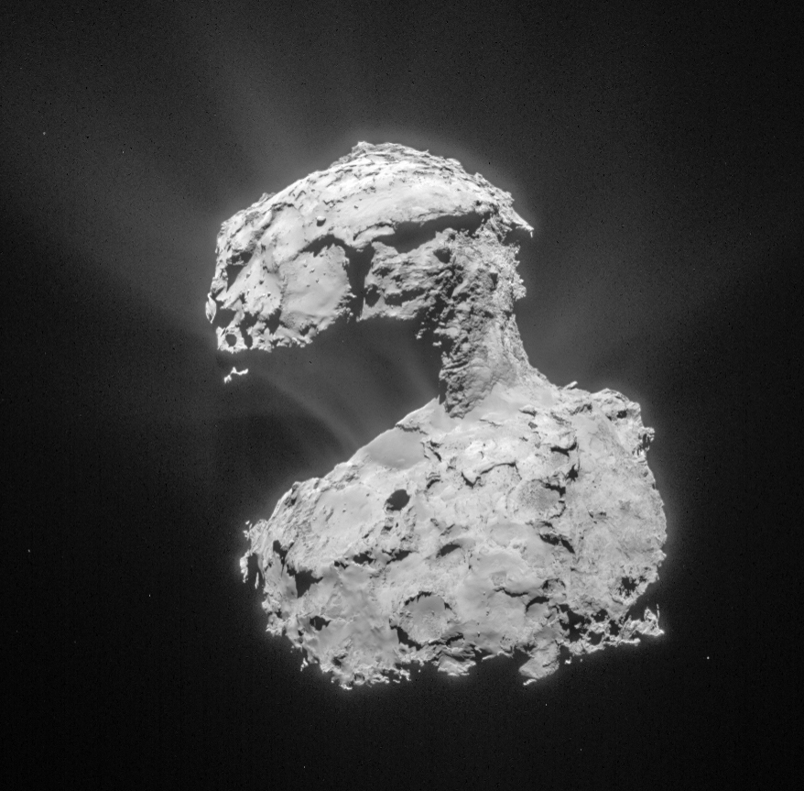
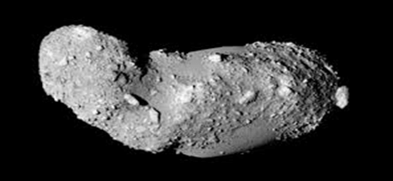
Which small Solar System bodies?
Introduction
Requirements
Sufficient property models available
Irregularly shaped and varied sizes
Research Question
Mission Overview
Methodology
Simulator Verification
Table 1: Key Parameters of Target Small Solar System Bodies
Results
Conclusions
Recommendations
Figure 1: Kleopatra (Top left), Comet 67P (Top right) and Itokawa (Bottom). (Not to scale)

Slide 9
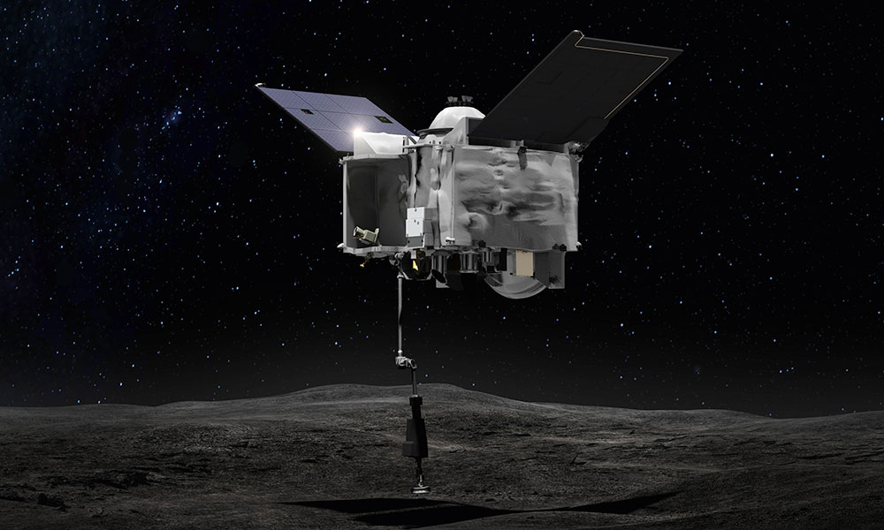
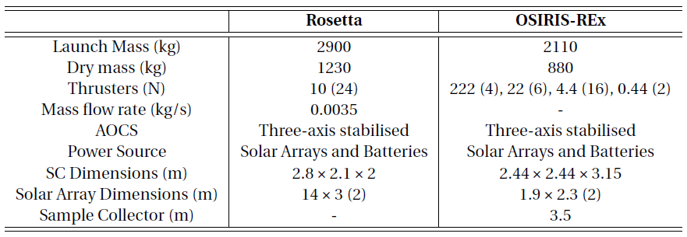
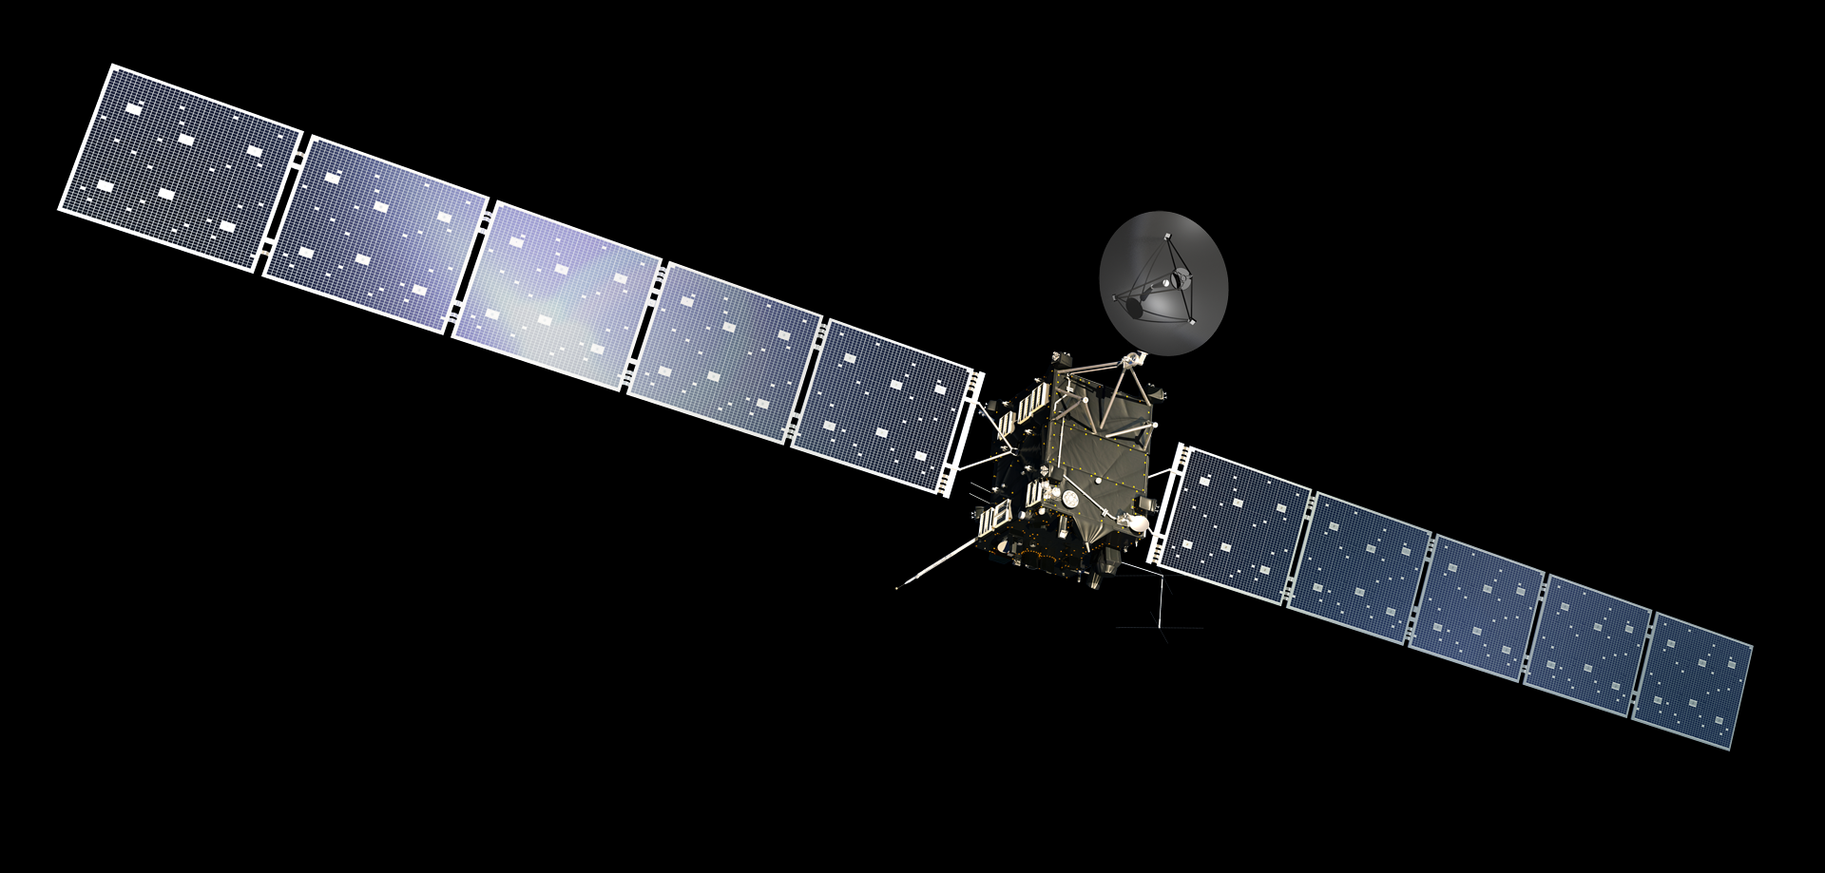
Which spacecrafts (SCs)?
Introduction
Requirements
Able to operate at a distance of 1.2~3 au from the Sun
Able to conduct descent on a small Solar System body
Research Question
Mission Overview
Methodology
Simulator Verification
Table 2: Specifications of Rosetta and OSIRIS-Rex as reference SCs for mapping and descent
Results
Conclusions
Recommendations
Figure 2: OSIRIS-REx (Top), Rosetta (Bottom). (Not to scale)

Slide 10
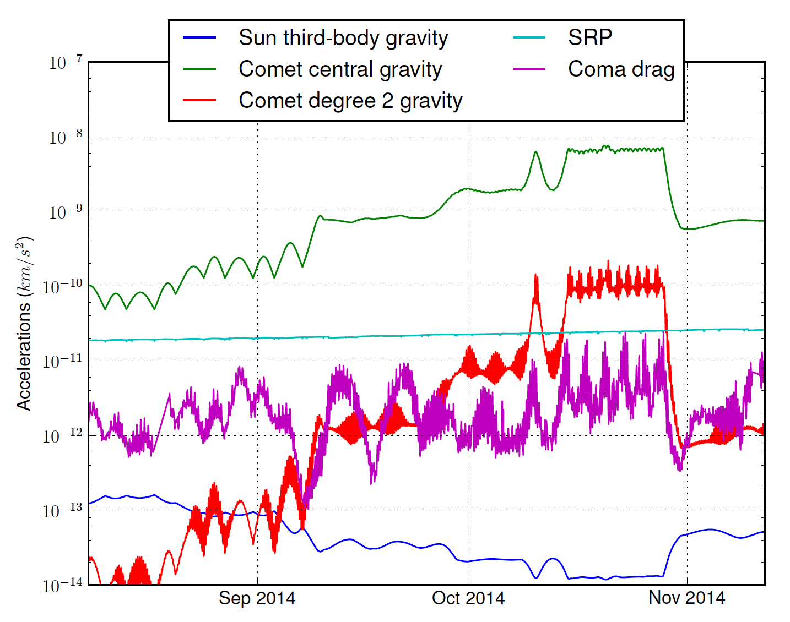
What is the environment like?
Introduction
Internal disturbances
Flexible dynamics
Sloshing
External disturbances
Perturbed gravity
Solar Radiation Pressure
Third Body Perturbation
Research Question
Mission Overview
Methodology
Simulator Verification
Results
Conclusions
Recommendations
Figure 3: Gravitational and perturbing accelerations on Rosetta, while performing close proximity operations at Comet 67P.

Slide 11
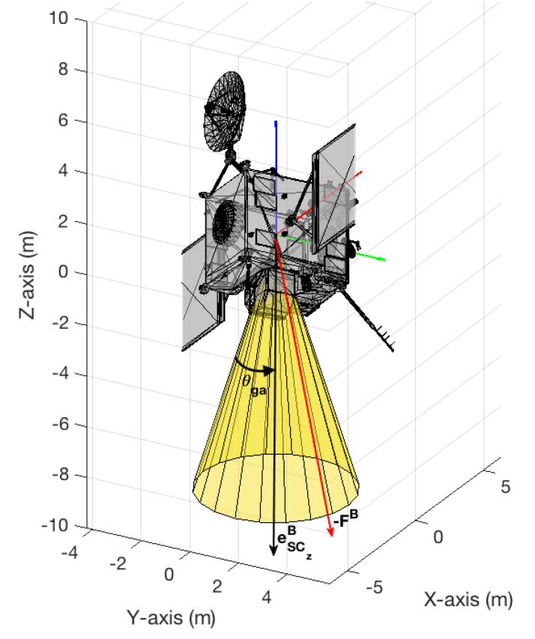
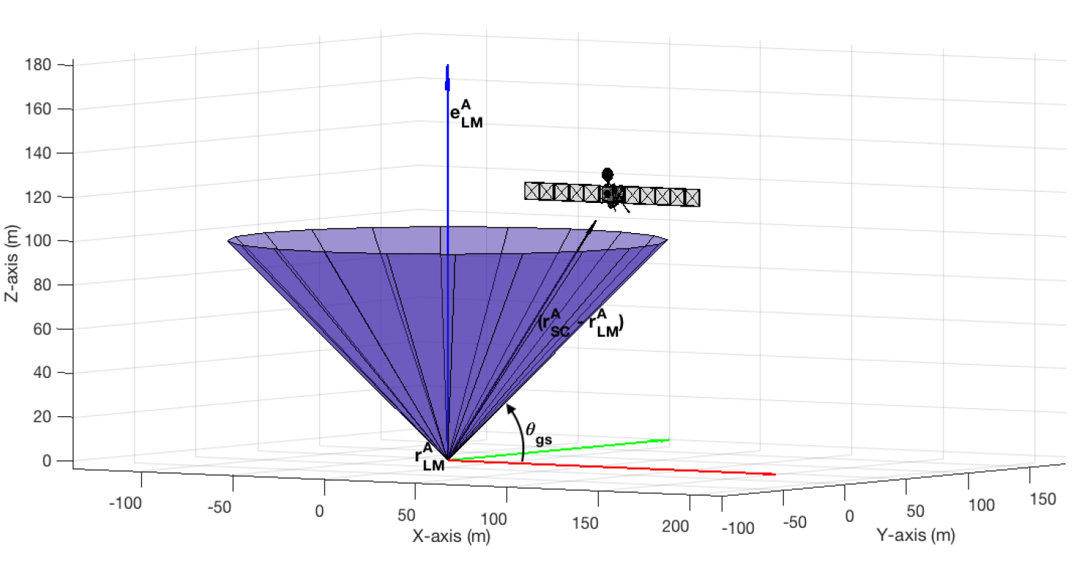
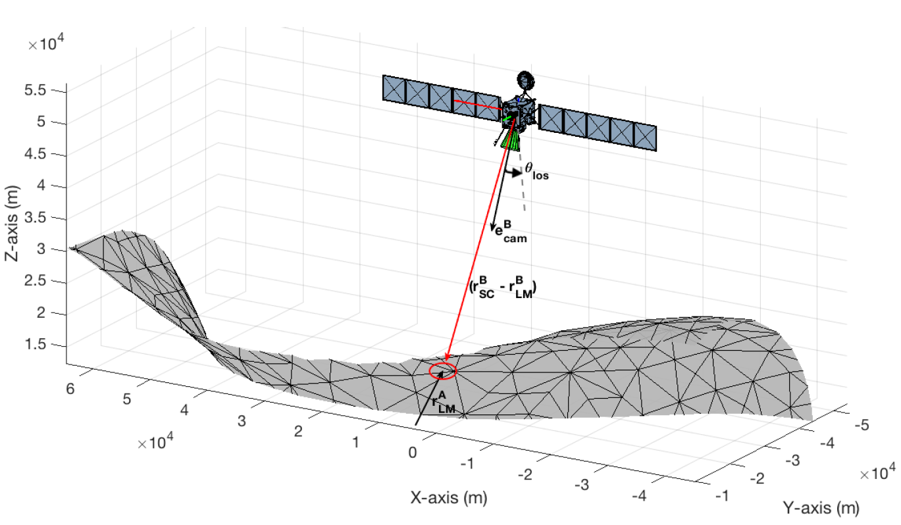
What is required from the descent guidance algorithm?
Introduction
Research Question
Minimum propellant consumption
Constrained SC altitude
Constrained SC attitude
Constrained SC angular rate
Constrained SC thrust
Optimal descent trajectory
Mission Overview
Methodology
Simulator Verification
Results
Conclusions
Recommendations
Figure 4: Physical representation of the glide-slope constraint.
Figure 6: Physical representation of the gimbal angle constraint.
Figure 5: Physical representation of the line of sight constraint.

Slide 12
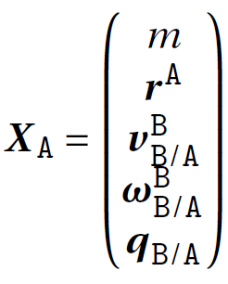
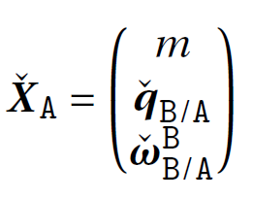
SC State Vectors
General 6DOF representation:
Introduction
Research Question
Mission Overview
Methodology
Simulator Verification
Results
Conclusions
DQ 6DOF representation:
Recommendations

Slide 13
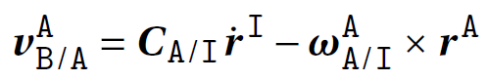
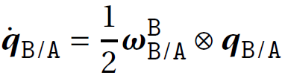
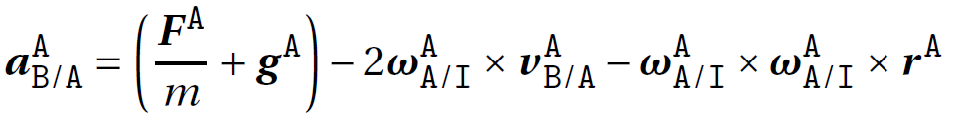
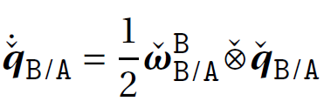
SC kinematics and dynamics in the asteroid rotating frame of reference (A)
Introduction
General 6DOF representation:
Research Question
Translational and Rotational Kinematics:
Mission Overview
Methodology
Simulator Verification
Translational and Rotational Dynamics:
Results
Conclusions
DQ 6DOF representation:
Recommendations
Translational and Rotational Kinematics:
Translational and Rotational Dynamics:

Slide 14
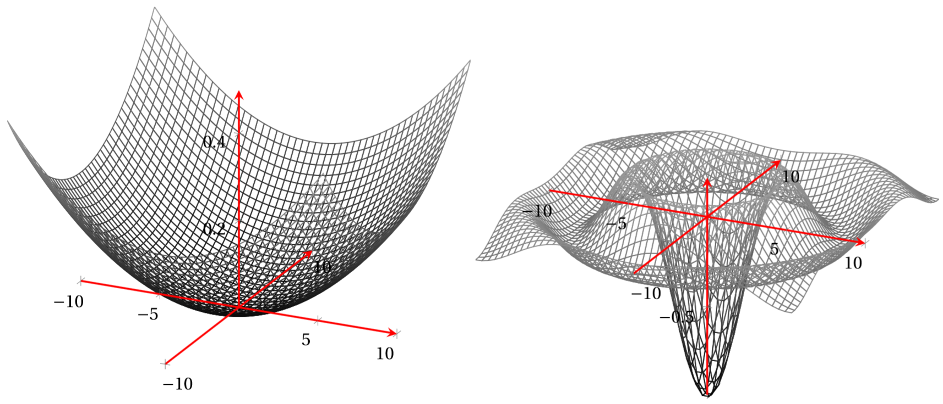
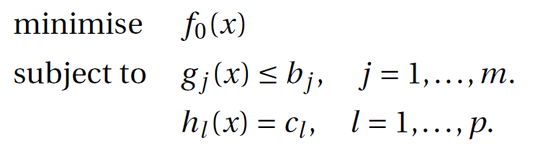
What is convex optimisation?
Introduction
General optimal control problem:
Objective/Cost function
Research Question
A subfield of mathematical optimisation
Minimise convex cost function
Feasible set: convex in nature
Mission Overview
Inequality constraints
x₂
Methodology
x₁
Equality constraints
Simulator Verification
x₁
x₂
Results
The cost function, inequality and equality constraints can be linear or non-linear.
An asteroid descent problem is ridden with these non-linearities.
Non-linear kinematics and dynamics
Non-linear state constraints (both equality and inequality)
Non-linear control constraints
Conclusions
Recommendations
Figure 4: Representations of a convex and non-convex function in 3D. (solid structures)
Notes:
A parabola is used to represent a convex function in Figure 6.5a, since it is easy to visualise, but it does not generalise convexity. In reality, convex sets are not intuitive or easy to visualise.
The selection of the different methods depends on the type of the OCP, As we will explain in the next slide linear programming is not an option, SDP involves semidefinite positive matrices, SOCP involves Second order cone

Slide 15
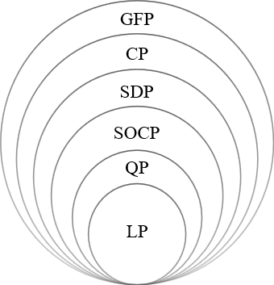
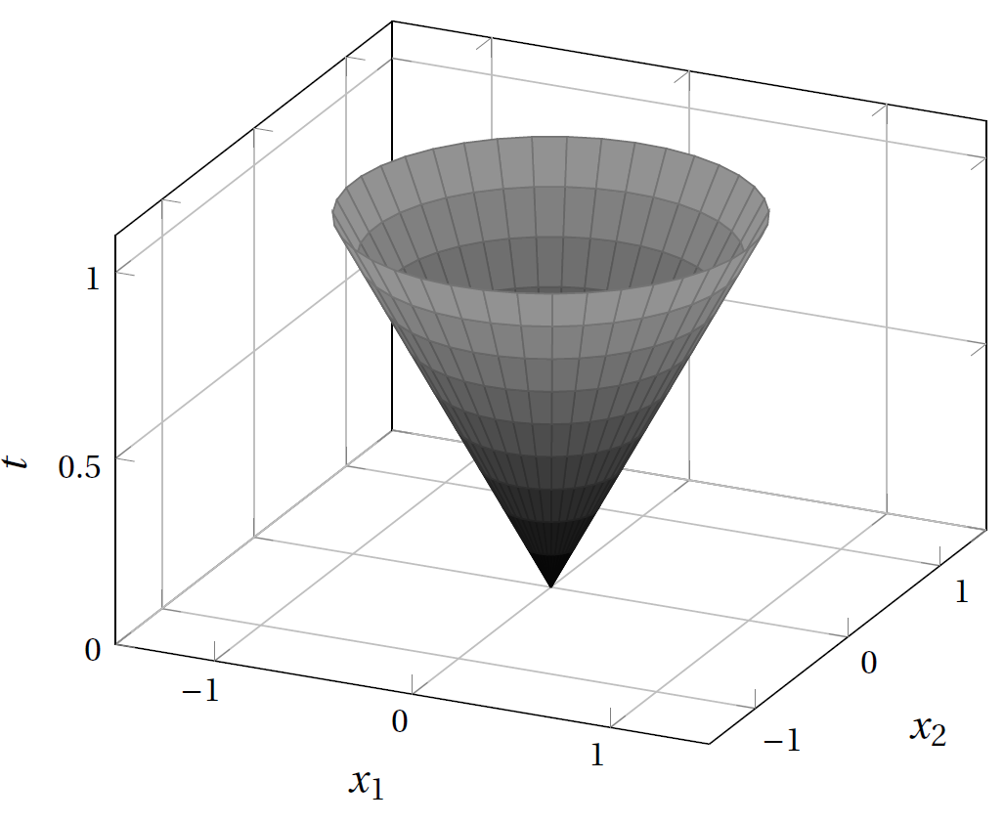
Convex optimisation benefits over other techniques
Introduction
Research Question
Linear Programming
Quadratic Programming
Second Order Conic Programming
Semi-Definite Programming
Conic Programming
Graph Form Programming
Mission Overview
Every local minimum is a global minimum
Optimal set is convex
Objective function is strictly convex
Methodology
Simulator Verification
Results
Conclusions
Recommendations
Figure 6: Second order cone boundary. It represents a filled cone.
Figure 5: Hierarchy of convex optimization problems.
Notes:
The obvious reason for using convex optimisation is the necessary existence of only one global minimum for convex function over its domain. The probability of getting stuck at a local minimum is, therefore, nil. Also, the negative gradient of the function will always lead to the optimum.

Slide 16
Original Problem Formulation
Introduction
Research Question
Mission Overview
Methodology
Simulator Verification
Results
Conclusions
Recommendations

Slide 17
Successive Convex Optimisation
Introduction
Research Question
Mission Overview
Methodology
Simulator Verification
Results
Conclusions
Recommendations

Slide 18
Dynamic Successive Convex Optimisation
Introduction
Research Question
Mission Overview
Methodology
Simulator Verification
Results
Conclusions
Recommendations

Slide 19
Sampling Based Model Predictive Optimisation
Introduction
Research Question
Mission Overview
Methodology
Simulator Verification
Results
Conclusions
Recommendations

Slide 20
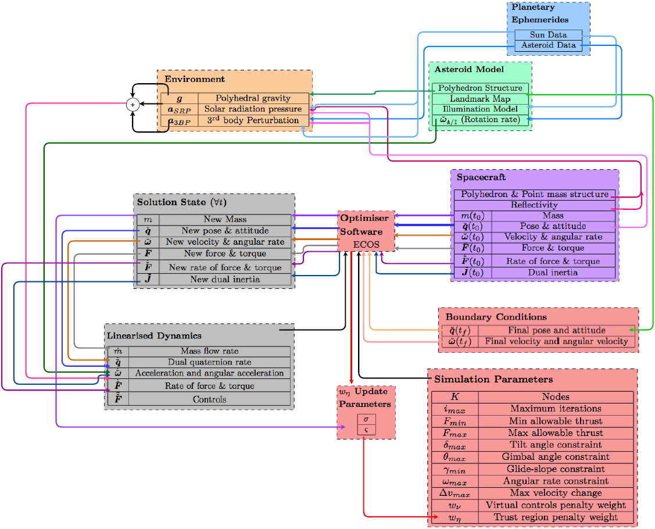
Simulator Architecture
Introduction
Research Question
Mission Overview
Methodology
Simulator Verification
Results
Conclusions
Recommendations
Figure 3: Simulator Architecture for Descent Guidance

Slide 21
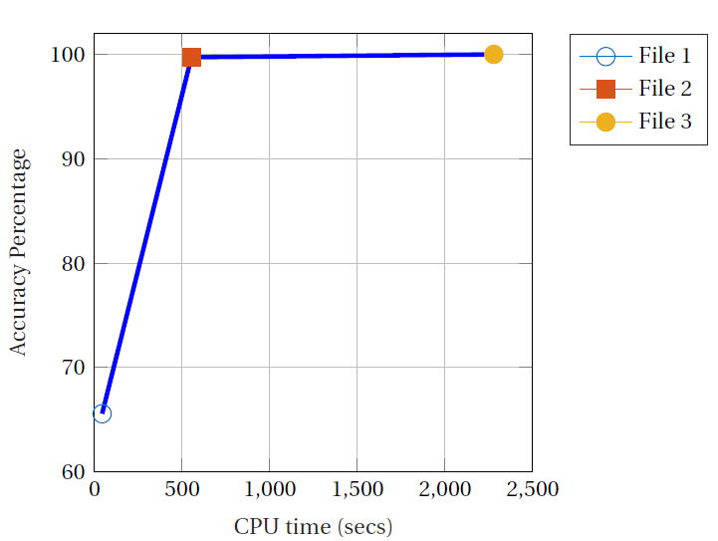
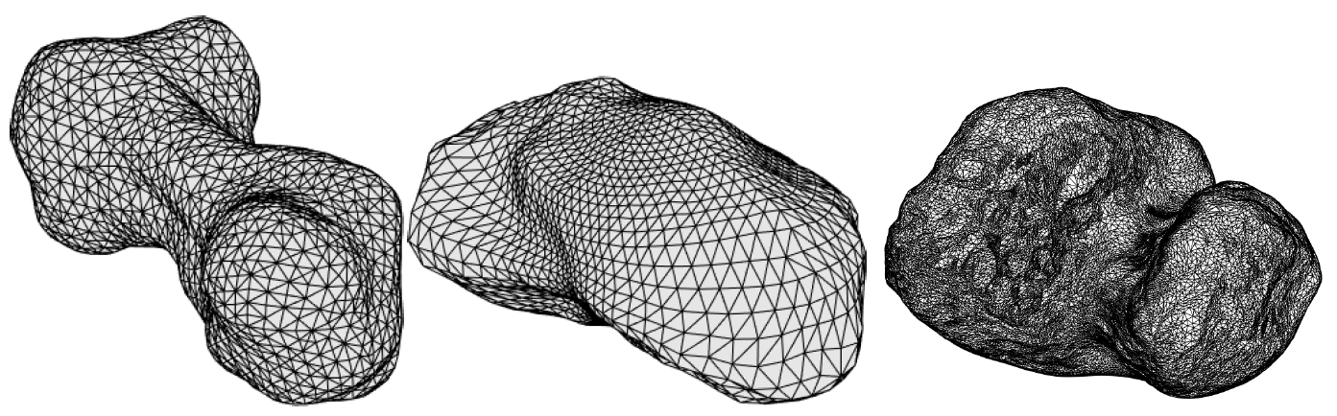
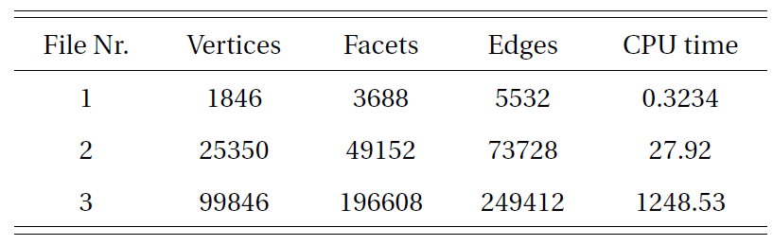
Asteroid Structure Models
Introduction
Research Question
Mission Overview
Methodology
Simulator Verification
Results
Conclusions
Recommendations

Slide 22
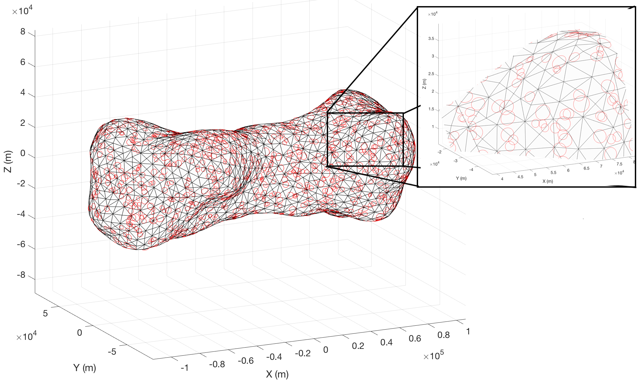
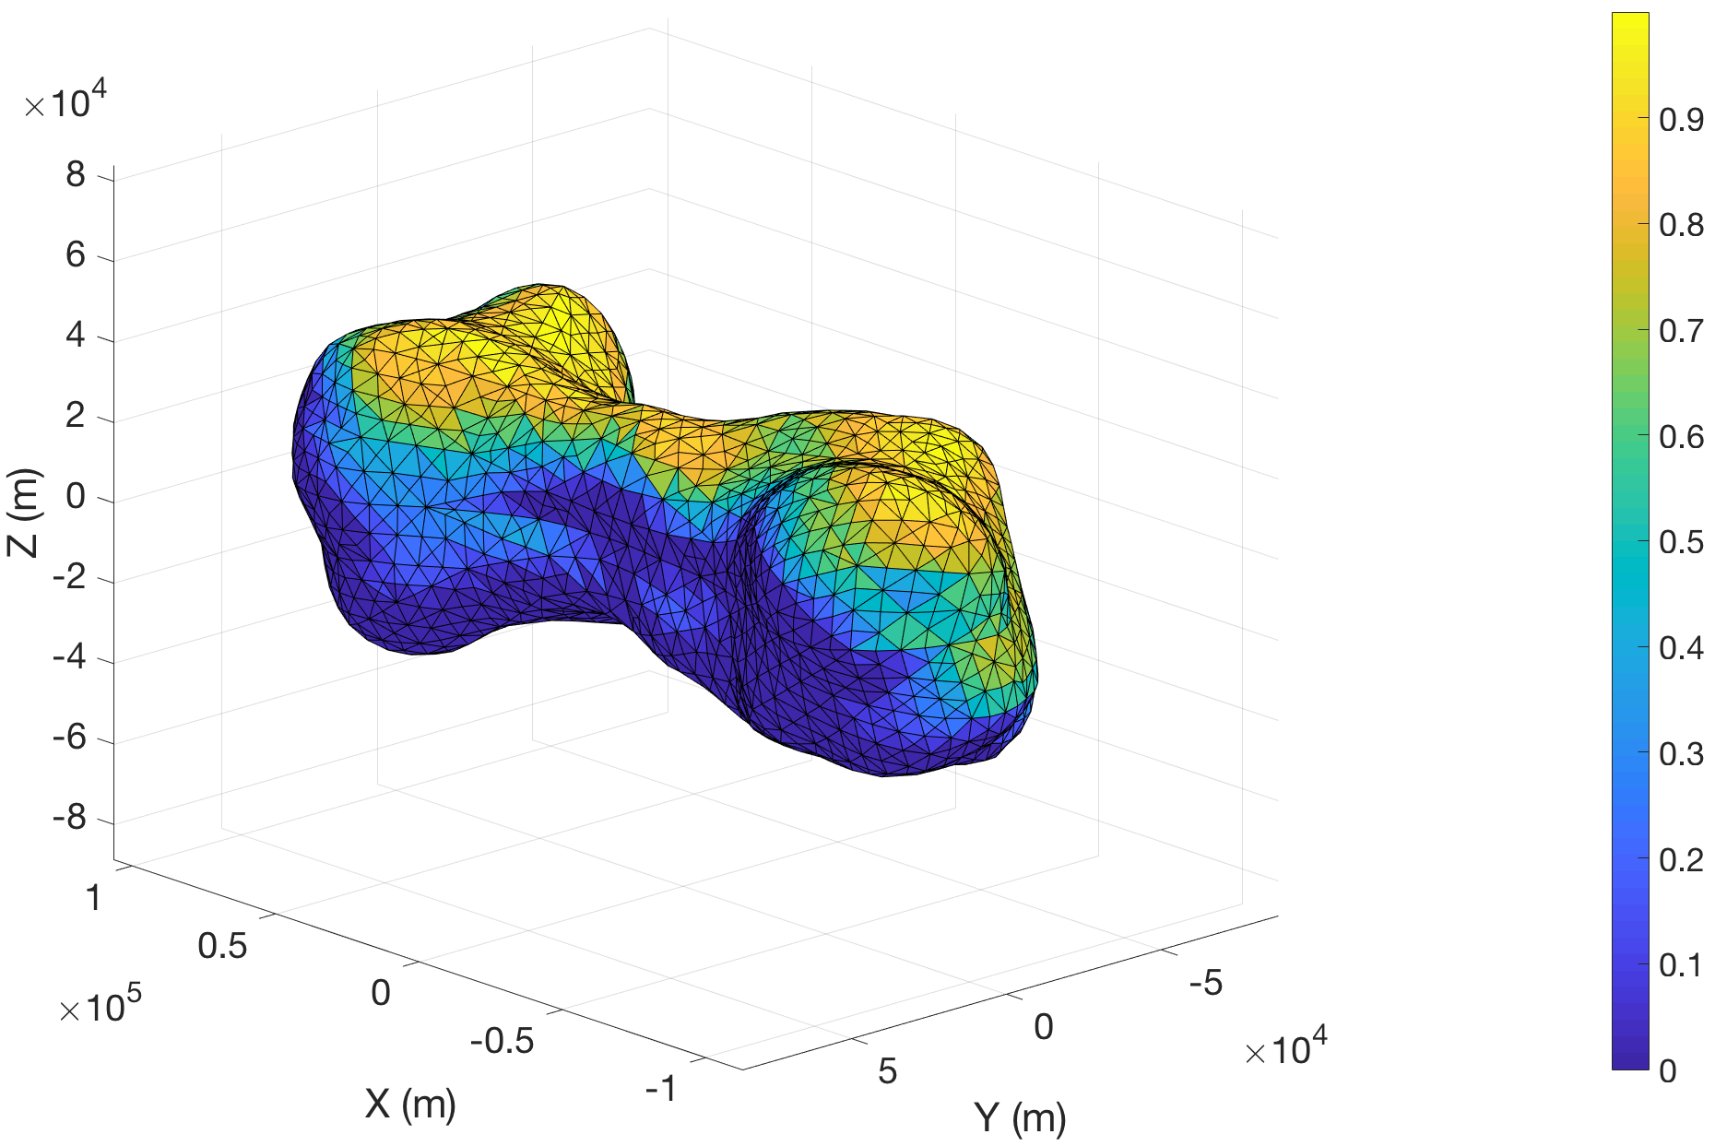
Additional Asteroid Models
Introduction
Research Question
Mission Overview
Methodology
Simulator Verification
Results
Conclusions
Recommendations

Slide 23
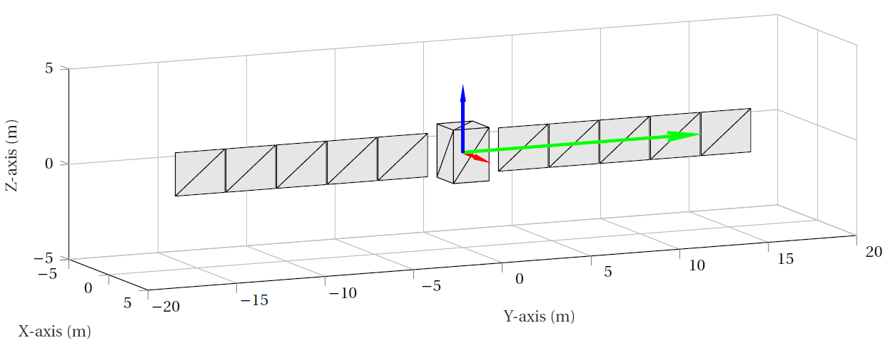
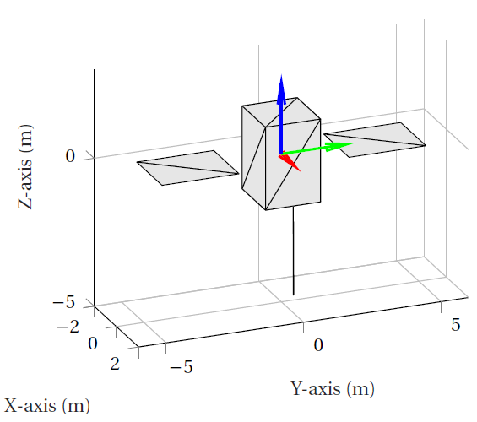
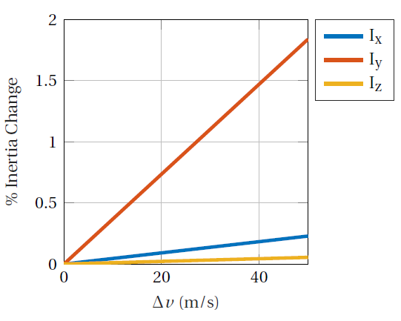
SC Structure Models
Introduction
Research Question
Mission Overview
Methodology
Simulator Verification
Results
Conclusions
Recommendations

Slide 24
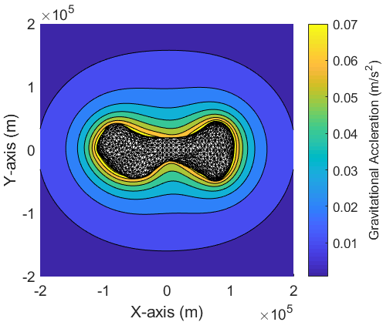
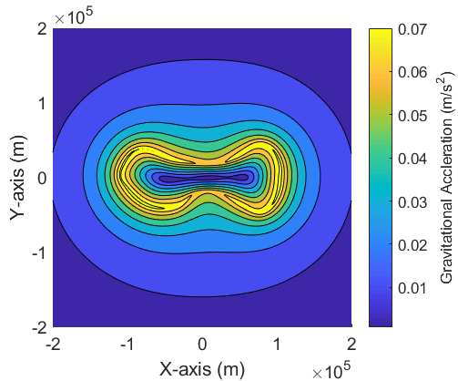
Gravity Models
Introduction
Research Question
Mission Overview
Methodology
Simulator Verification
Results
Conclusions
Recommendations

Slide 25
DQ Kinematics and Dynamics
Introduction
Research Question
Mission Overview
Methodology
Simulator Verification
Results
Conclusions
Recommendations

Slide 26
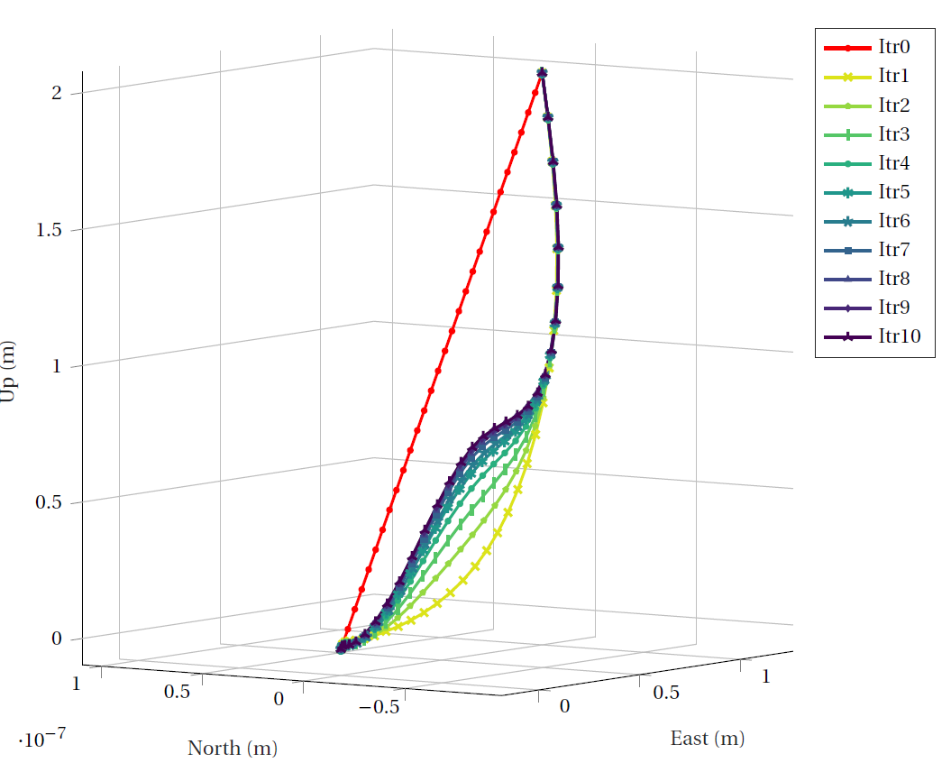
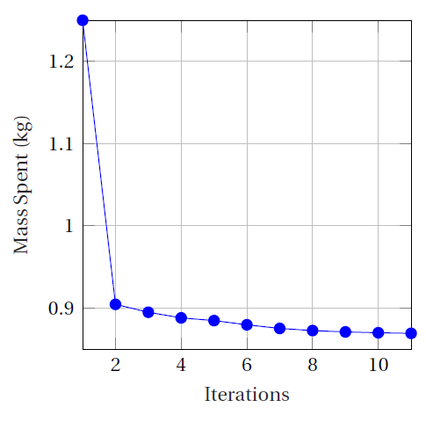
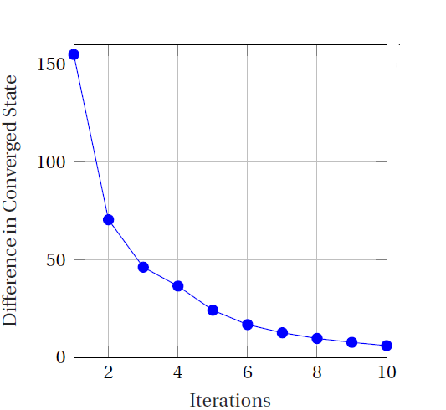
Dynamic Successive Convex Optimisation (Mars 6DOF)
Introduction
Research Question
Mission Overview
Methodology
Simulator Verification
Results
Conclusions
Recommendations

Slide 27
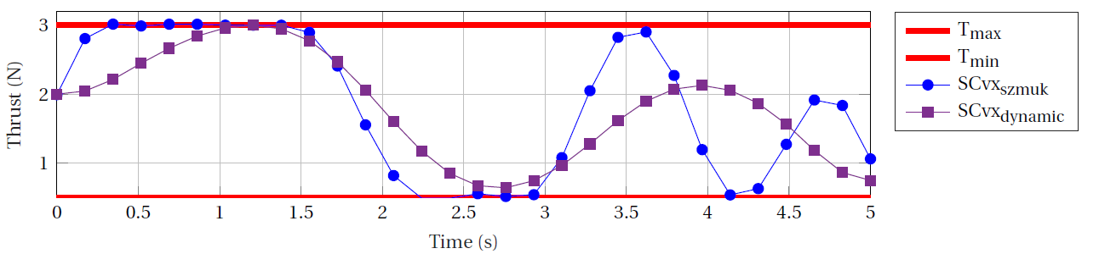
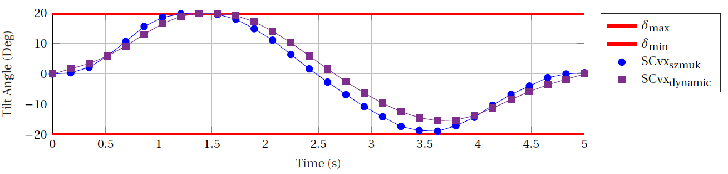
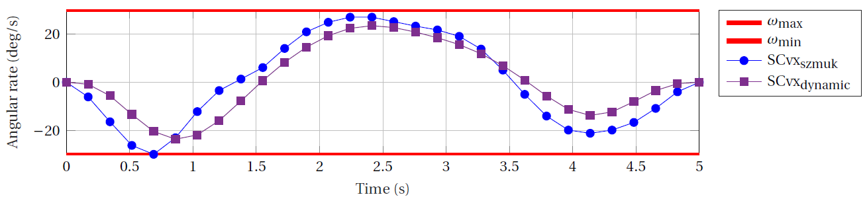
Dynamic Successive Convex Optimisation (Mars 6DOF)
Introduction
Research Question
Mission Overview
Methodology
Simulator Verification
Results
Conclusions
Recommendations

Slide 28
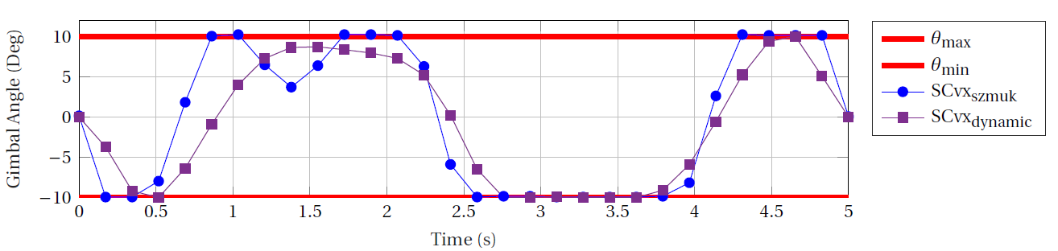
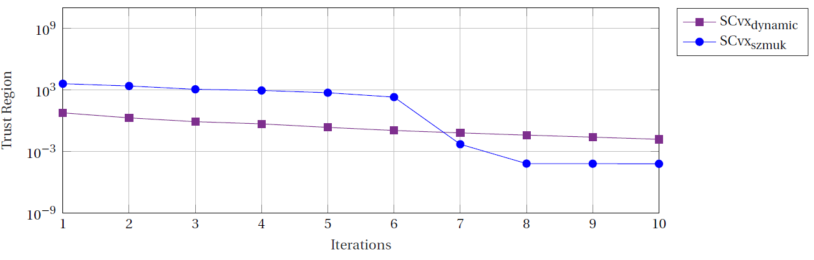
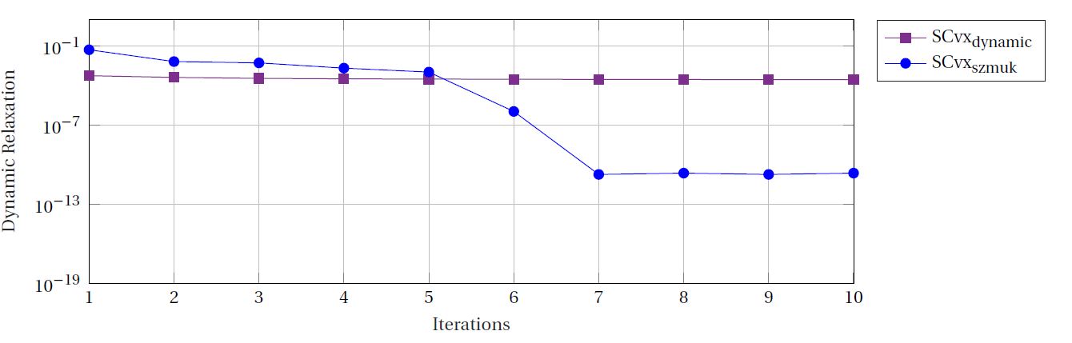
Dynamic Successive Convex Optimisation (Mars 6DOF)
Introduction
Research Question
Mission Overview
Methodology
Simulator Verification
Results
Conclusions
Recommendations

Slide 29
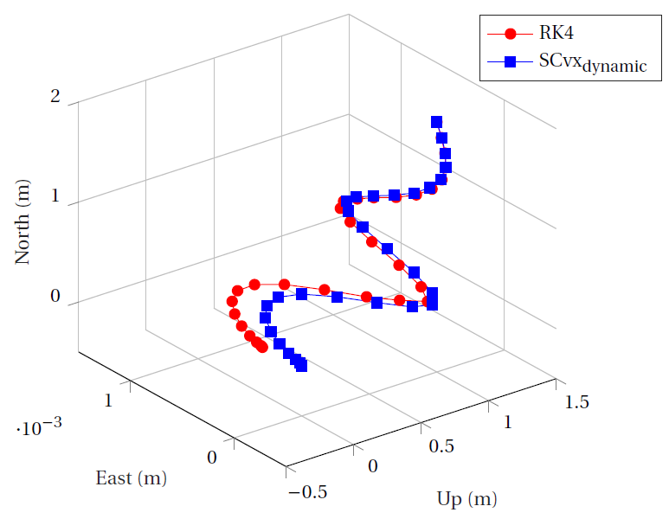
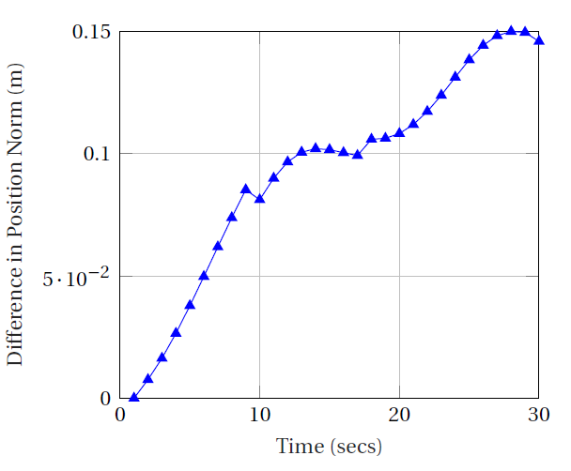
Dynamic Successive Convex Optimisation (Mars 6DOF)
Introduction
Research Question
Mission Overview
Methodology
Simulator Verification
Results
Conclusions
Recommendations

Slide 30
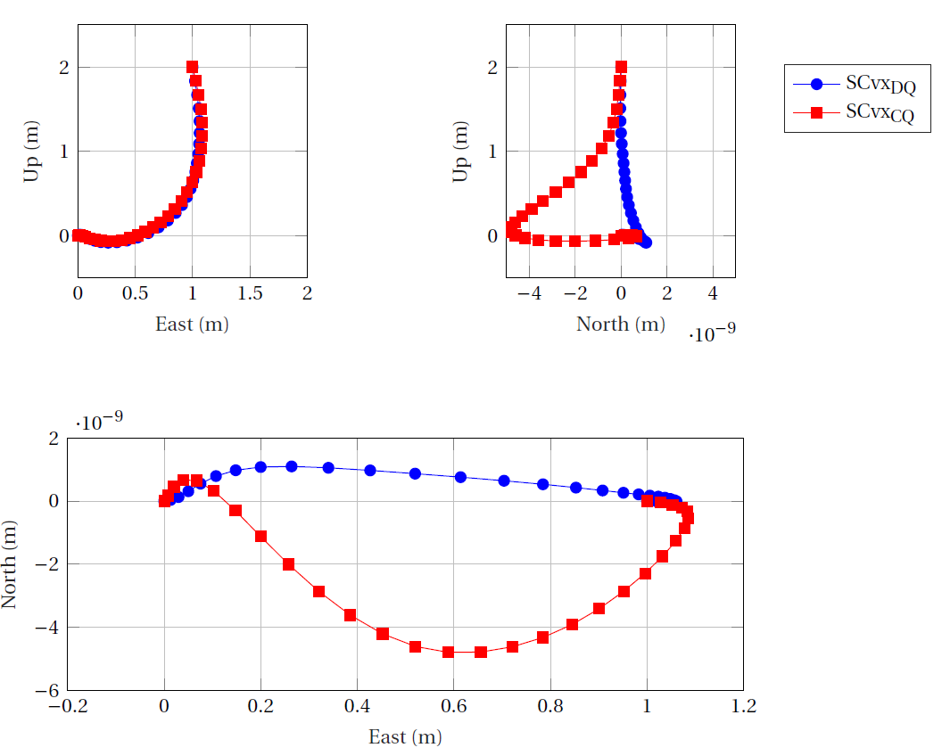
Dynamic Successive Convex Optimisation (Mars 6DOF DQs)
Introduction
Research Question
Mission Overview
Methodology
Simulator Verification
Results
Conclusions
Recommendations

Slide 31


Dynamic Successive Convex Optimisation (Mars 6DOF DQs)
Introduction
Research Question
Mission Overview
Methodology
Simulator Verification
Results
Conclusions
Recommendations

Slide 32


Dynamic Successive Convex Optimisation (Mars 6DOF DQs)
Introduction
Research Question
Mission Overview
Methodology
Simulator Verification
Results
Conclusions
Recommendations

Slide 33



Dynamic Successive Convex Optimisation (Mars 6DOF DQs)
Introduction
Research Question
Mission Overview
Methodology
Simulator Verification
Results
Conclusions
Recommendations

Slide 34

Dynamic Successive Convex Optimisation (Mars 6DOF DQs)
Introduction
Research Question
Mission Overview
Methodology
Simulator Verification
Results
Conclusions
Recommendations

Slide 35
Scenario 1
Introduction
Research Question
Mission Overview
Methodology
Simulator Verification
Results
Conclusions
Recommendations

Slide 36
Scenario 2
Introduction
Research Question
Mission Overview
Methodology
Simulator Verification
Results
Conclusions
Recommendations

Slide 37

DQ Scenario 1 and 2
Introduction
Research Question
Mission Overview
Methodology
Simulator Verification
Results
Conclusions
Recommendations

Slide 38

Asteroid Mapping Initialisation
Introduction
Research Question
Mission Overview
Methodology
Simulator Verification
Results
Conclusions
Recommendations

Slide 39

Asteroid Mapping Initialisation
Introduction
Research Question
Mission Overview
Methodology
Simulator Verification
Results
Conclusions
Recommendations

Slide 40

Asteroid Mapping Initialisation
Introduction
Research Question
Mission Overview
Methodology
Simulator Verification
Results
Conclusions
Recommendations

Slide 41

Asteroid Mapping Initialisation
Introduction
Research Question
Mission Overview
Methodology
Simulator Verification
Results
Conclusions
Recommendations

Slide 42

Asteroid Mapping Initialisation
Introduction
Research Question
Mission Overview
Methodology
Simulator Verification
Results
Conclusions
Recommendations

Slide 43
Introduction
Research Question
Mission Overview
Methodology
Simulator Verification
Results
Conclusions
Recommendations

Slide 44
Introduction
Research Question
Mission Overview
Methodology
Simulator Verification
Results
Conclusions
Recommendations

Slide 45
References
https://www.space.com/30213-asteroid-mining-planetary-resources-2025.html
https://www.nasa.gov/content/what-is-nasa-s-asteroid-redirect-mission
https://www.asteroidmission.org/?latest-news=nasa-mission-reveals-asteroid-big-surprises
https://www.extremetech.com/extreme/286238-hayabusa-2-successfully-collects-sample-from-asteroid-ryugu

Slide 46
Questions?
Thank You!

